Slide 1

Supervision and Monitoring

Slide 2
Supervisor
First line supervisor
  Directly responsible for average 3 vaccination teams
  Accountable for all aspects of the campaign in areas allocated to him/her.
Selection:
  Health supervisors, block level ICDS and other key block level government functionaries
  Should be familiar with the area allocated to them.
  Well motivated, physically fit and supportive of the vaccination teams.
Must receive training in the technical & operational aspects
Each supervisor should be independently mobile.
Supportive and proactive supervision at every level for best results

Slide 3
Monitor
Designated State and District level Officers
Responsible for overseeing allotted districts/ blocks/ urban areas
To visit areas of responsibility meticulously
  Before the activity for monitoring the preparedness
  During the activity to monitor implementation.
Identify constraints in the process & find solutions
Feed-back to national/state/district/Block on the quality and completeness of the preparedness, implementation and review process.

Slide 4
Supervision
Responsibilities
  Pre-campaign
  During Implementation
  Post-Campaign

Slide 5
Pre-campaign Responsibilities
Familiarize themselves with the area allocated
Assist BMO /PHC-MO in formulating accurate micro plans
  Collating all data (villages by population, schools etc.)
  Selecting appropriate session-site locations
  Selecting vaccinators, ASHA, AWW and volunteers
  Rational distribution of teams and session-sites
  Developing proper maps (School, Outreach, HRA)
Check that logistic distribution plan is realistic
Validate every area (village/ward/pocket/hamlet) through field visits

Slide 6
Pre-campaign Responsibilities
Coordinate and facilitate with ANMs, ASHA, AWW and volunteers under his/her area to ensure that all are trained
Ensure that all team members know the nearest AEFI management points and their contact details
Make random visits to the field to ensure that ASHA has completed distribution of invitation cards in her area/village/ward.

Slide 7
Responsibilities- During Campaign
Use Supervisory-Checklist to assess quality and ensure complete vaccination coverage in the community
Should be Independently mobile and must carry logistics for replenishment
School session-site: Eligible children from all classes in the school are being immunized
At Outreach session-sites: Local ASHA/AWW mobilizing children to the session-site from the community
Proactively support the teams working as mobile/special teams for hard to reach/high risk area-populations

Slide 8
Responsibilities – During Campaign
Visit each session site at least twice a day to check:
  Last minute absenteeism of vaccinators, shortage of vaccines/logistics and solve them
  Safe injection practices followed (cold chain, aseptic precautions, safe disposal etc.)
  Record of vaccination is being maintained properly
  Parents are being provided with record of vaccination
  Parents of under-five children are reminded of other multiple routine immunization doses
  Proper information about AEFI is being provided

Slide 9
Responsibilities – During Campaign
Visit all the areas where teams have completed their work the previous day and assess the vaccination coverage using supervisors’ check-list, as the tool
Based on their findings the PHC-MO will decide on the appropriate corrective response
At the end of the day’s activity, supervisors will collect, compile and analyse data from all her/his vaccination teams
Attend the evening meeting each day at planning unit/block and give feedback to medical officer and implement mid-course corrective measures, required on the ground

Slide 10
Responsibilities- Post Campaign
Plan and organize sweeping/repeat vaccination activities in the last week, for areas with low-coverage and missed pockets/high risk areas-population, based on
  Supervisors check-list observations
  Rapid Convenience Monitoring findings
  Sub-optimal reported coverage data
  Feedback from the ground
If there are only a few missed children, ensure that all of them are immunized in nearest MR campaign site or in subsequent RI session only for ‘campaign dose for missed children’.

Slide 11
Monitoring by State/District Observers
and External-Monitors

Slide 12
During Preparatory-stage
All state/district observers should attend STFI and DTFI (task force meetings) and report back to the State on quality and effectiveness of these review meeting
Review the micro-plans to ensure that:
  Includes all components and all geographical areas.
  Realistic and adequate logistic and cold chain plans.
  Appropriate team composition as per the given guideline.
  Trained vaccinators and assistants identified.
  All High risk areas are included
  IEC/ IPC & other Social Mobilization plans are available
Following the State workshop, National Level Observers will visit the States for preparedness assessment

Slide 13
During Implementation stage
Visit their pre-allotted/designated-areas to assess quality & completeness of coverage of population / community
Use standardized monitoring formats for making rapid convenience monitoring (RCM) of the quality of activity in an area (prioritizing high risk area-population)
Suggest
  Immediate corrective actions like repeating the activity
  Mid-course corrective actions like
    Re-training of vaccinators,
    Review of micro-plans midway, if need arises
Help plan for sweeping activity in last week of campaign

Slide 14

Responsibilities - Post Campaign
Process level assessment:
Review meetings (DTFI/STFI) at District and State levels
Supervision and monitoring questionnaires and findings are analysed to provide quantitative information related to the process of implementing the activity and coverage
  End of activity RCM (Rapid Convenience Monitoring)
End objective is to achieve 100% coverage of the target population in the blocks (villages/wards) with safety
Documentation of the best practices and lessons learned to ensure better quality and safety of subsequent phases of MR vaccination campaign in future.

Slide 15
Responsibilities - Post Campaign
Output level assessment
% vaccination coverage achieved.
There will be two approaches
  Administratively based on campaign reported coverage
  Conventional household surveys, using EPI cluster sampling methodologies (practiced as the gold standard)

Slide 16
Summary
Follow-up visits by National Level Observers for preparedness & implementation
Supervision & Monitoring by state and district level monitors will be the key to ensuring:
  Timeliness and quality of preparations
  Quality and completeness of implementation and coverage
  Ensuring accountability at all levels
Involvement of first-line supervisor in preparatory phase will ensure realistic micro - planning
Quality of first line supervision will ensure that all teams conduct quality sessions and achieve completeness of coverage, prioritizing high risk area/population (HRA/P)
High quality coverage with safety is paramount.

Slide 17
Tools for use by supervisor and monitor

Slide 18
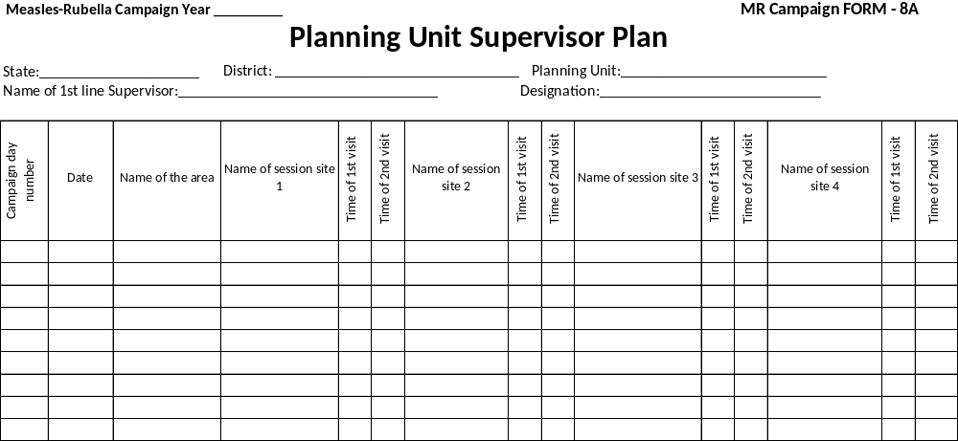

Slide 19
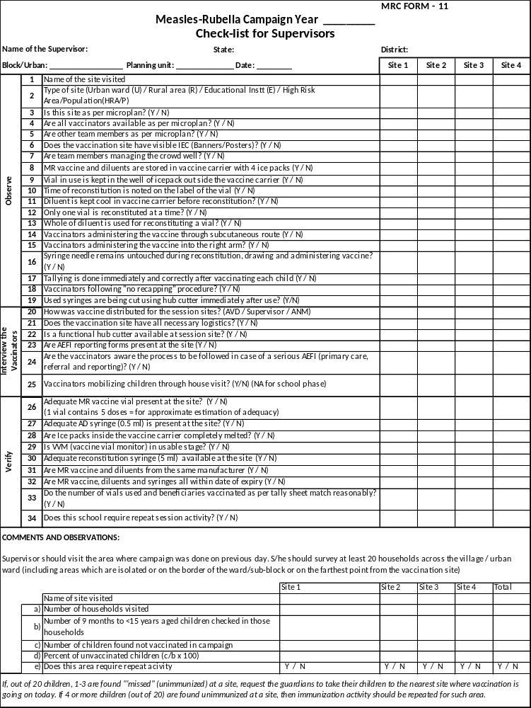
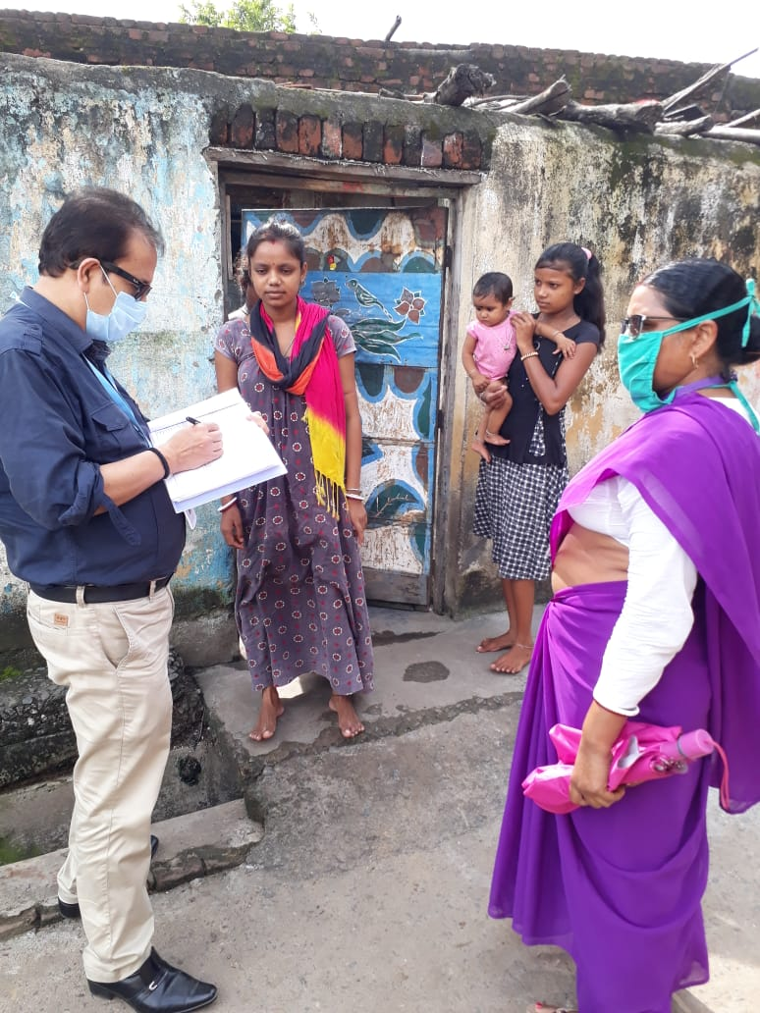
Check-list for Supervisors
Session activity
  Observe
  Interview of vaccinators
  Verify
B. Community activity
(visit to 20 households)

Slide 20
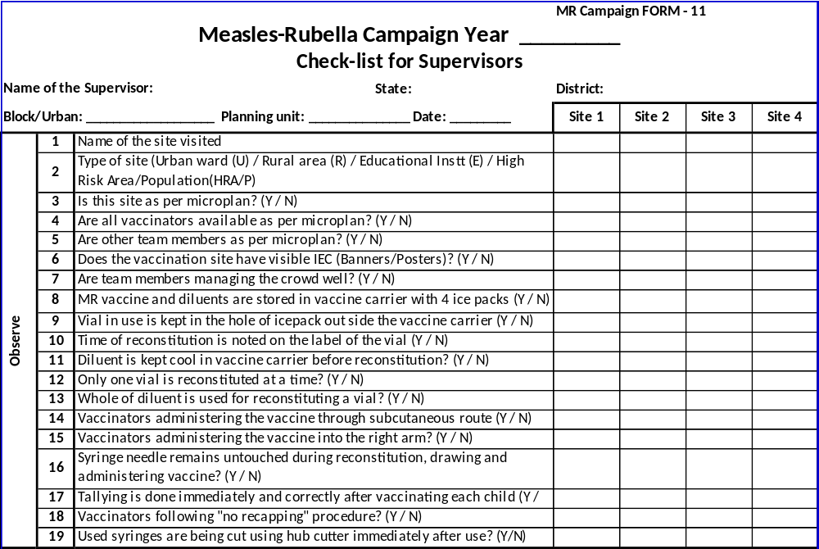
Check-list for Supervisors (1 of 3)

Slide 21
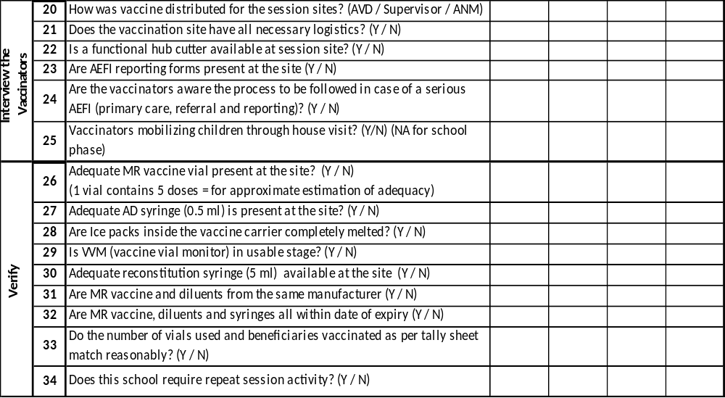
Check-list for Supervisors (2of 3)

Slide 22
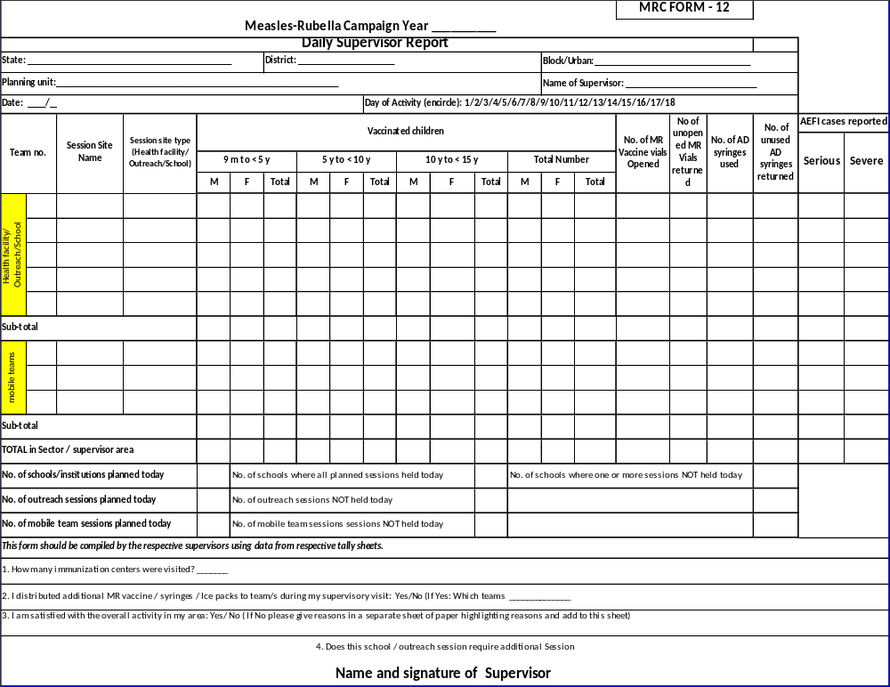

Slide 23
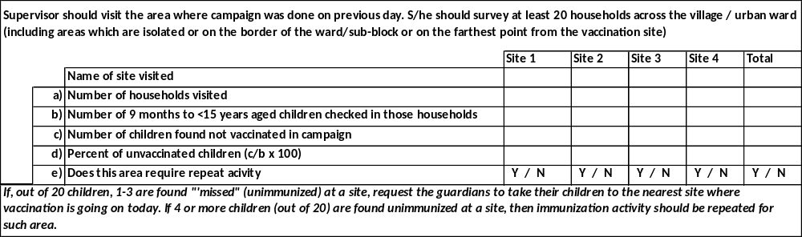
Check-list for Supervisors (3of 3)

Slide 24
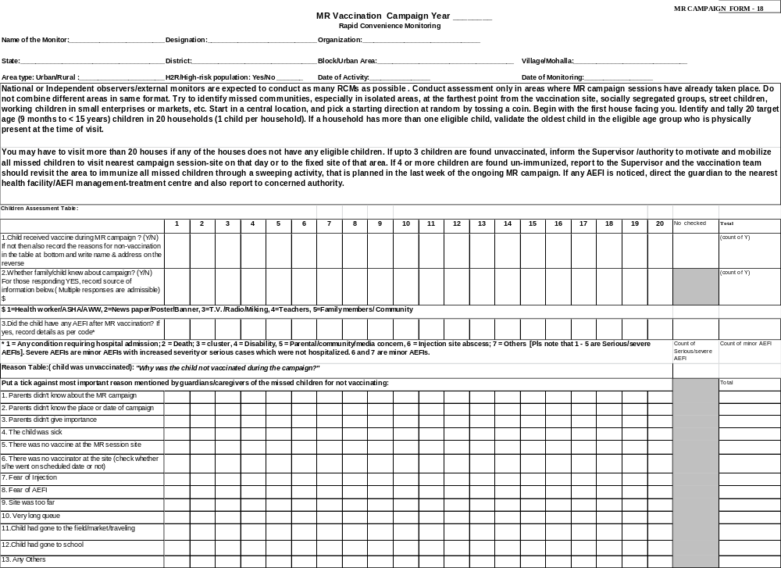

Slide 25
Some practices requiring
supervisors/monitors feedback

Slide 26
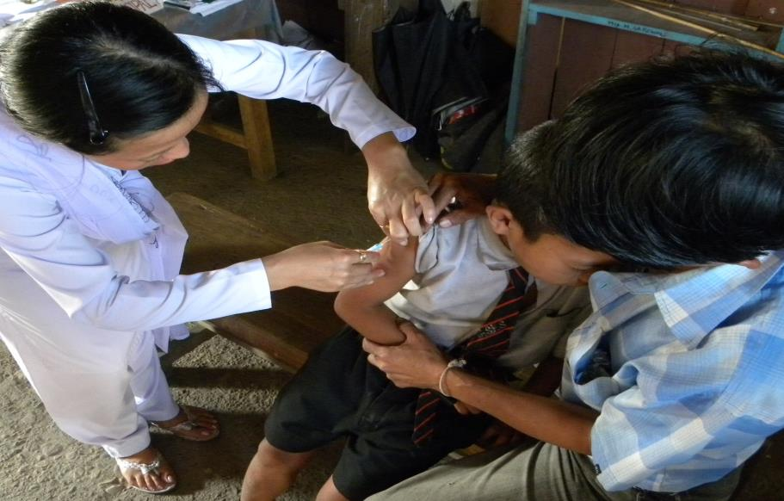
WHAT SHOULD THE SUPERVSOR DO ?

Slide 27
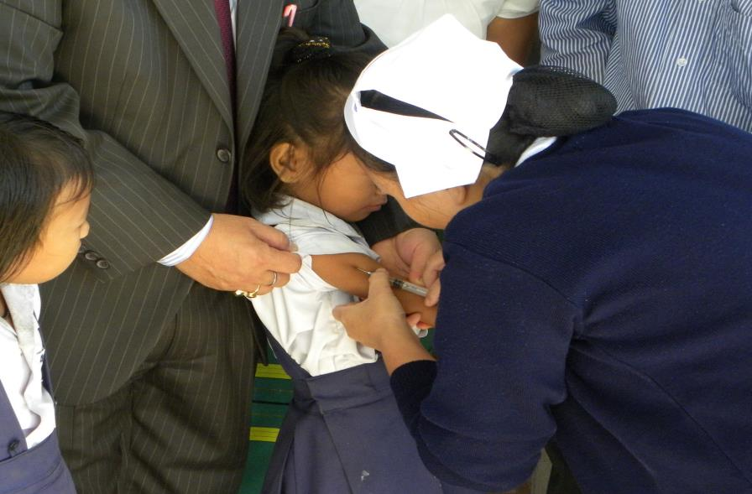
WHAT SHOULD THE SUPERVSOR DO ?

Slide 28
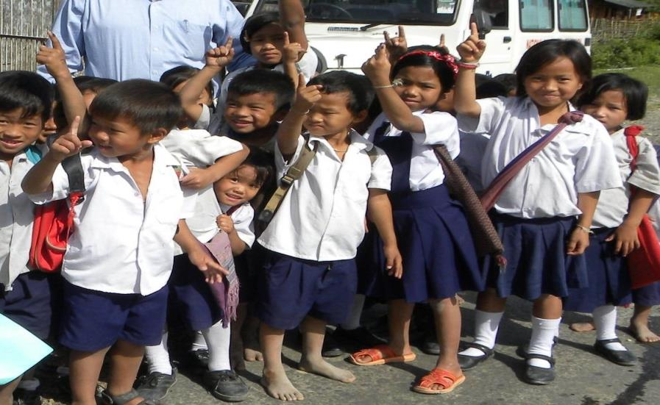
WHAT SHOULD THE SUPERVSOR DO ?

Slide 29
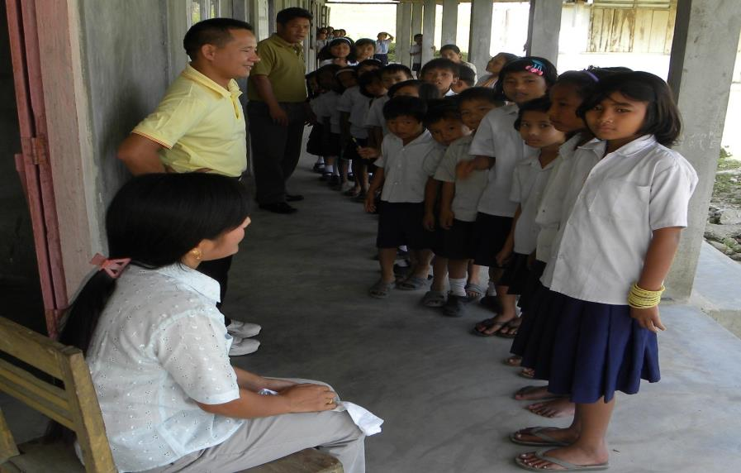
WHAT SHOULD THE SUPERVSOR DO ?

Slide 30
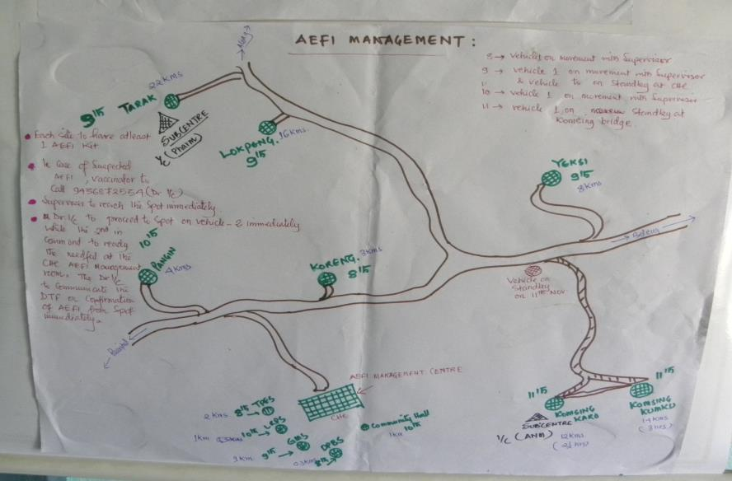
WHAT SHOULD THE SUPERVSOR DO ?

Slide 31
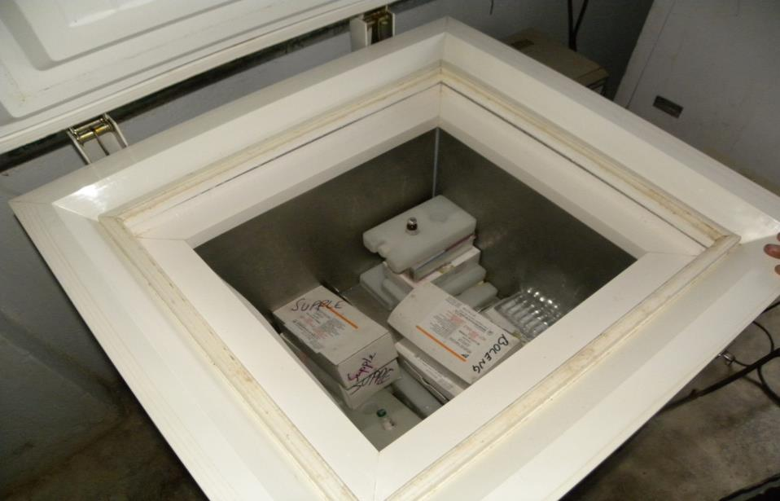
WHAT SHOULD THE SUPERVSOR DO ?

Slide 32
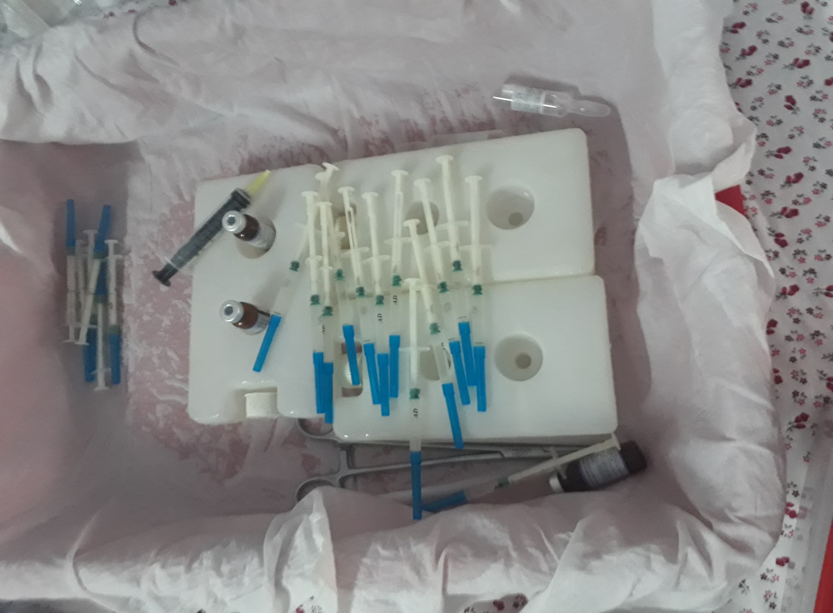
WHAT SHOULD THE SUPERVSOR DO ?

Slide 33
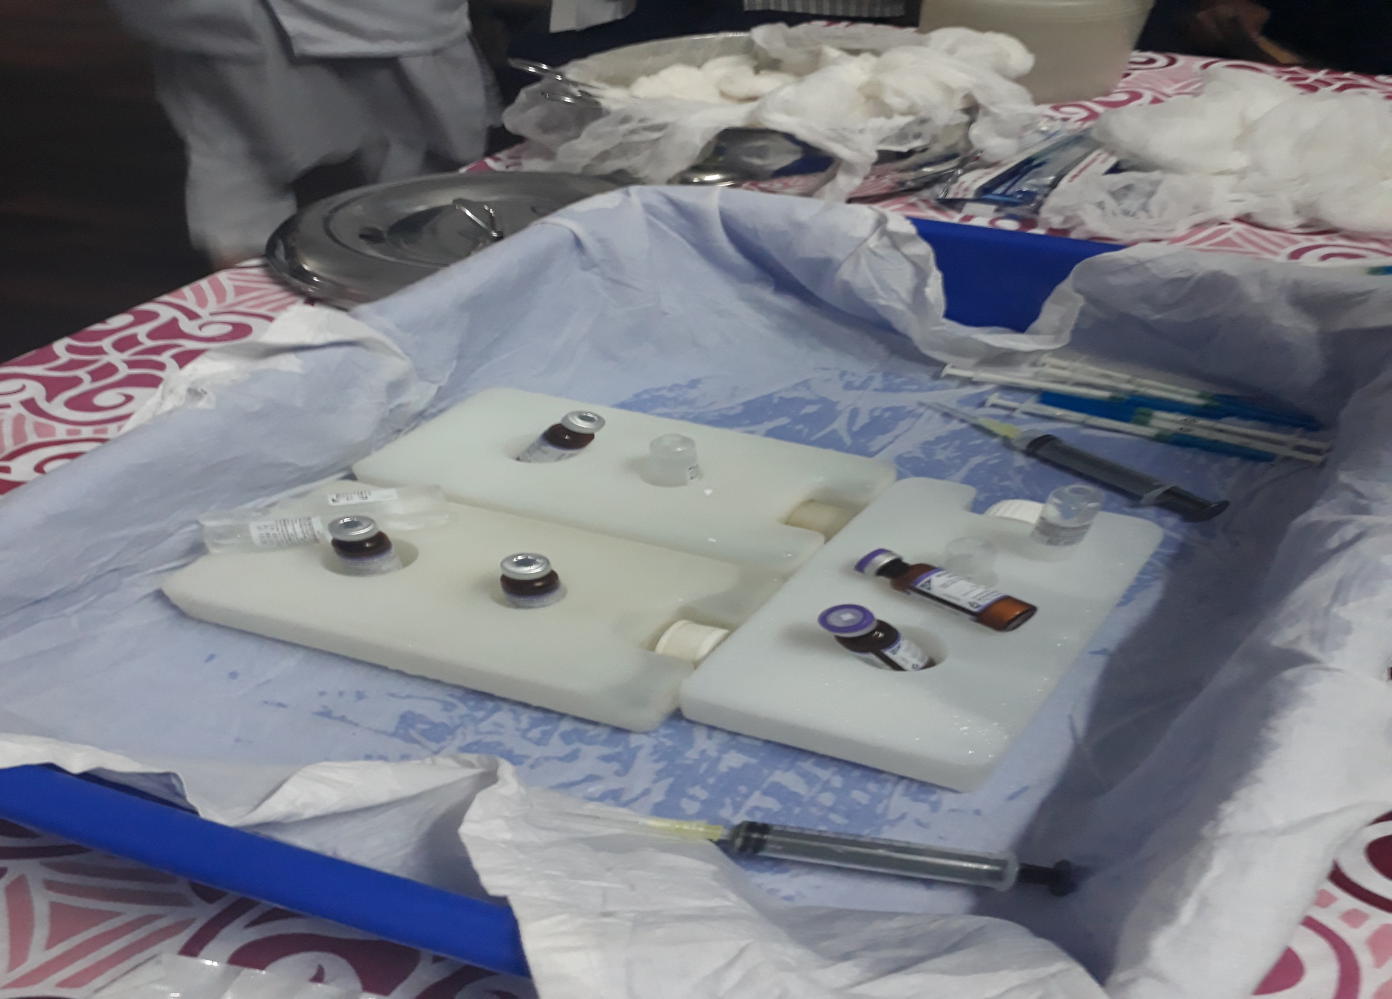
WHAT SHOULD THE SUPERVSOR DO ?

Slide 34
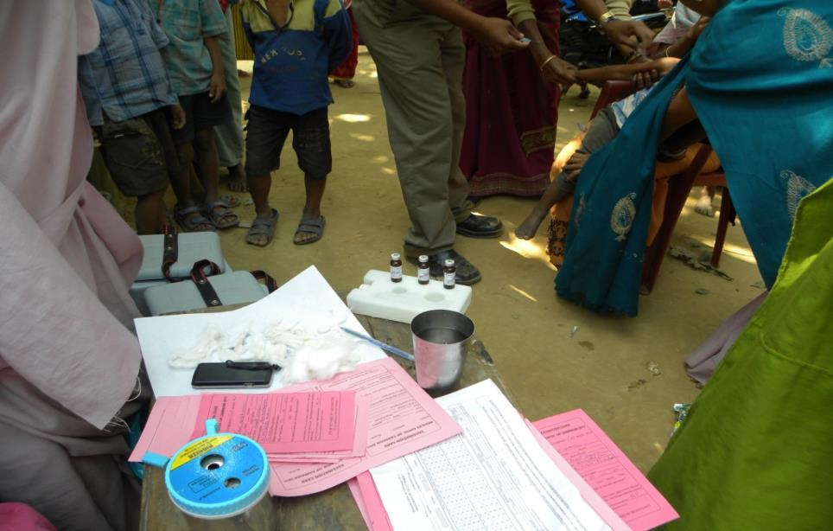
WHAT SHOULD THE SUPERVSOR DO ?

Slide 35
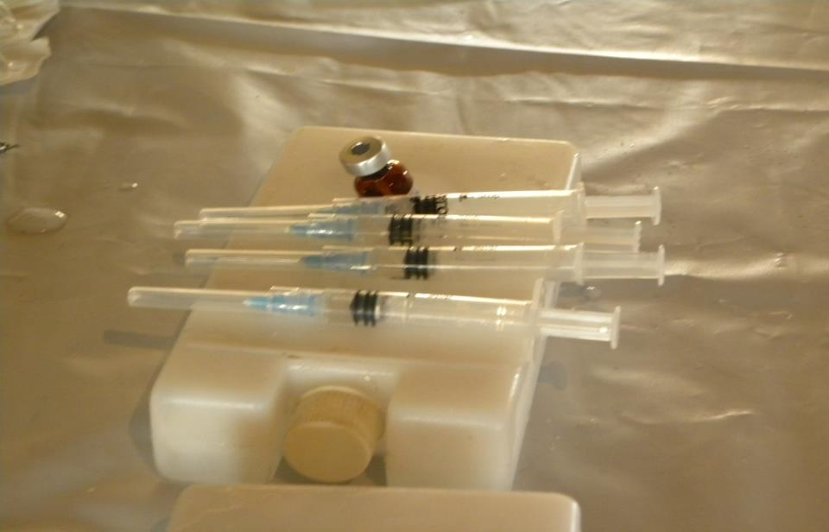
WHAT SHOULD THE SUPERVSOR DO ?

Slide 36
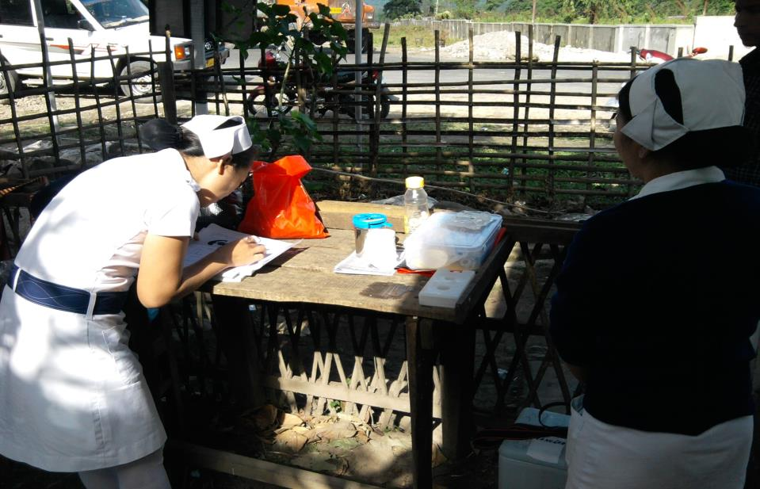
WHAT SHOULD THE SUPERVSOR DO ?

Slide 37
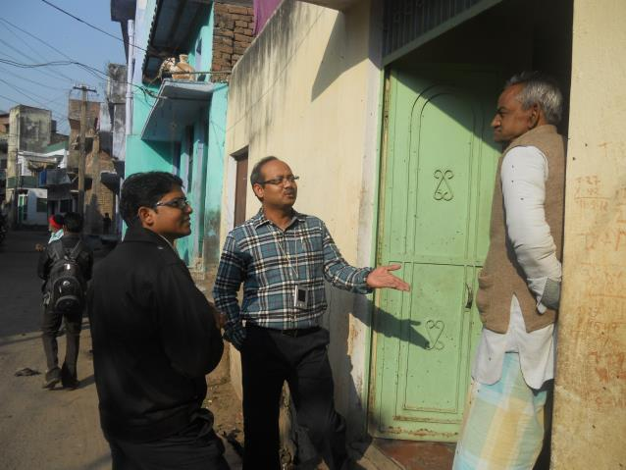
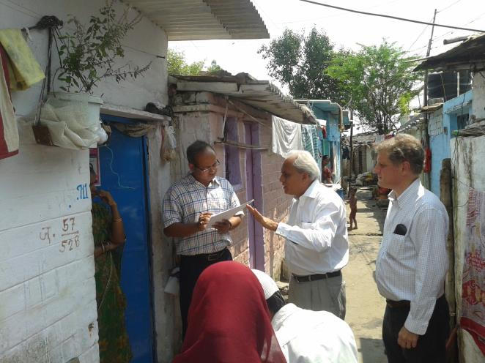
…..Thank you…..

